Slide 1


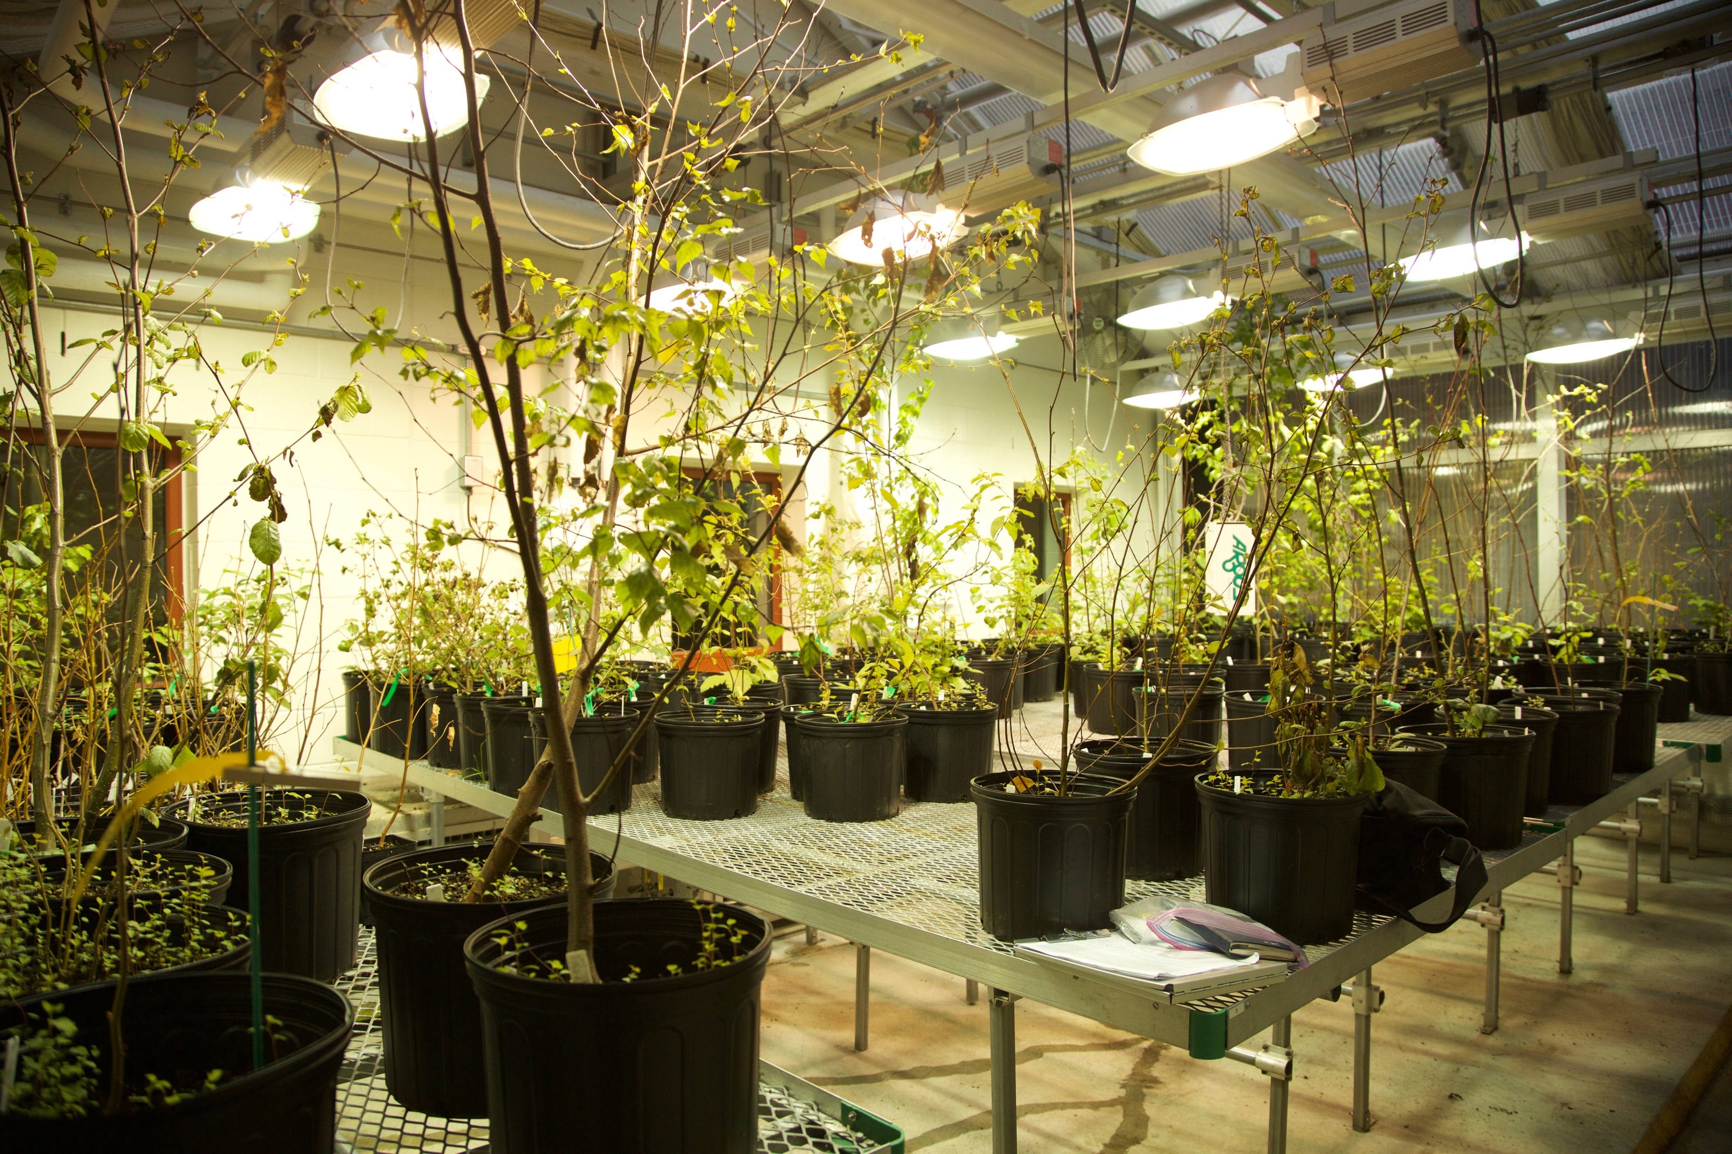
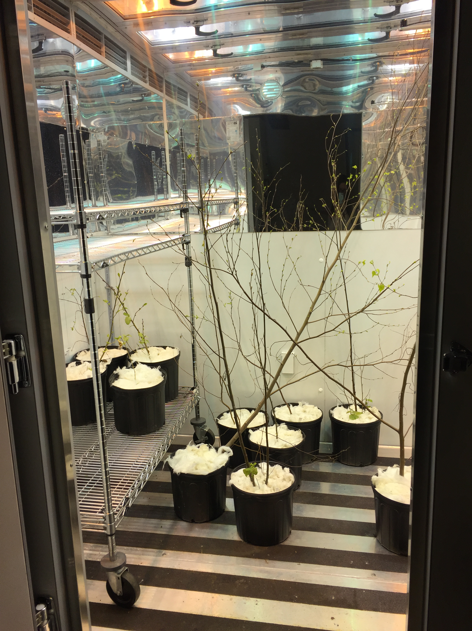
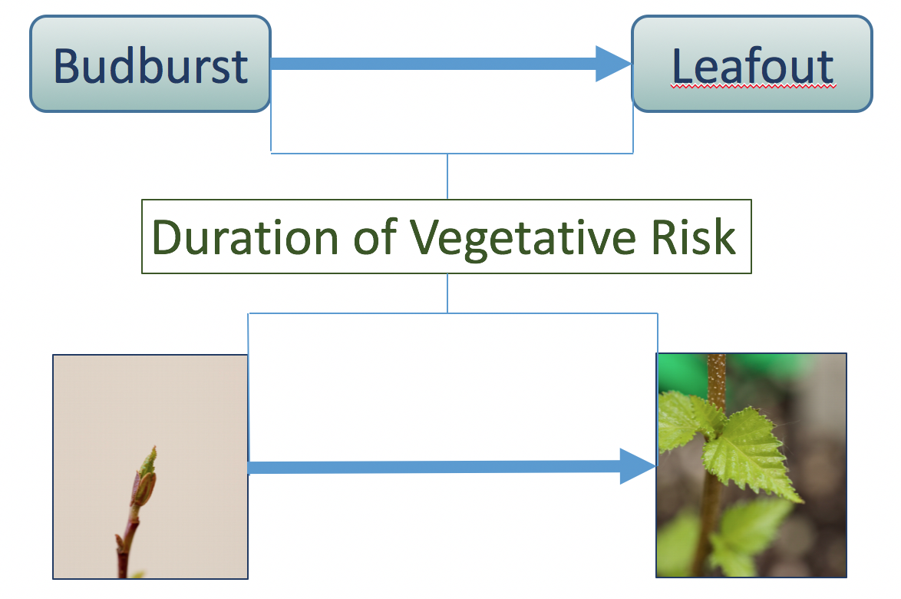
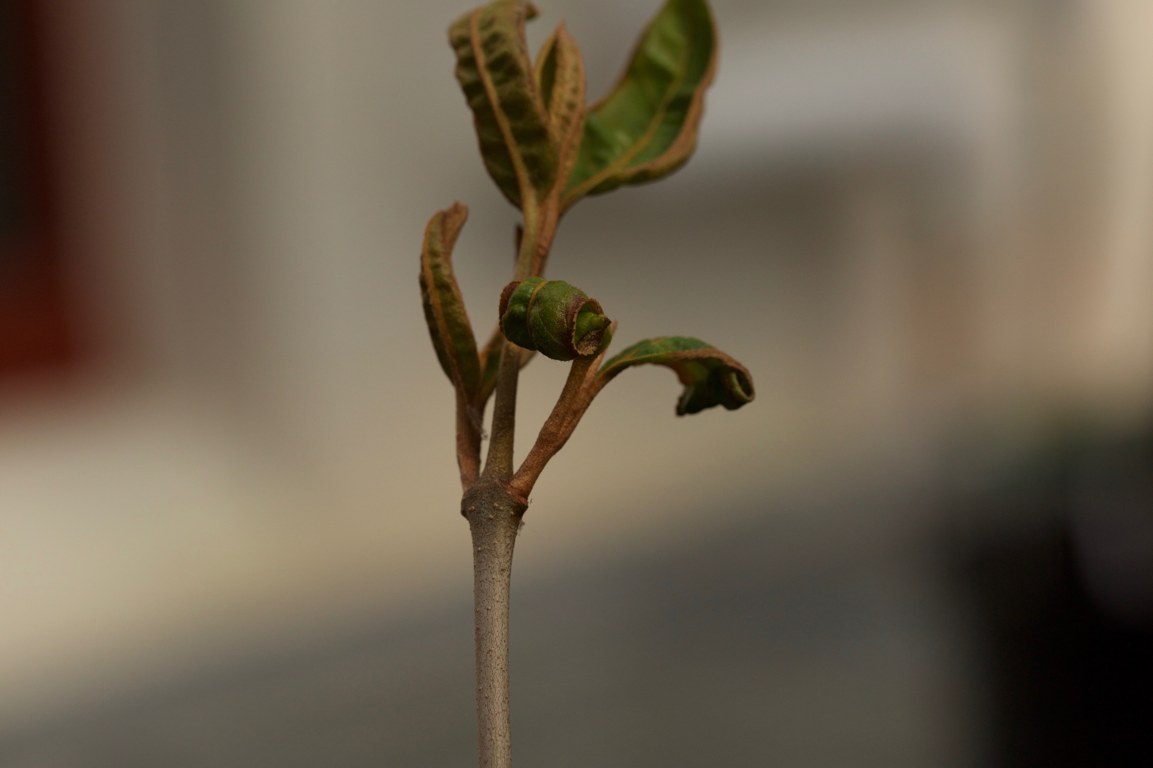
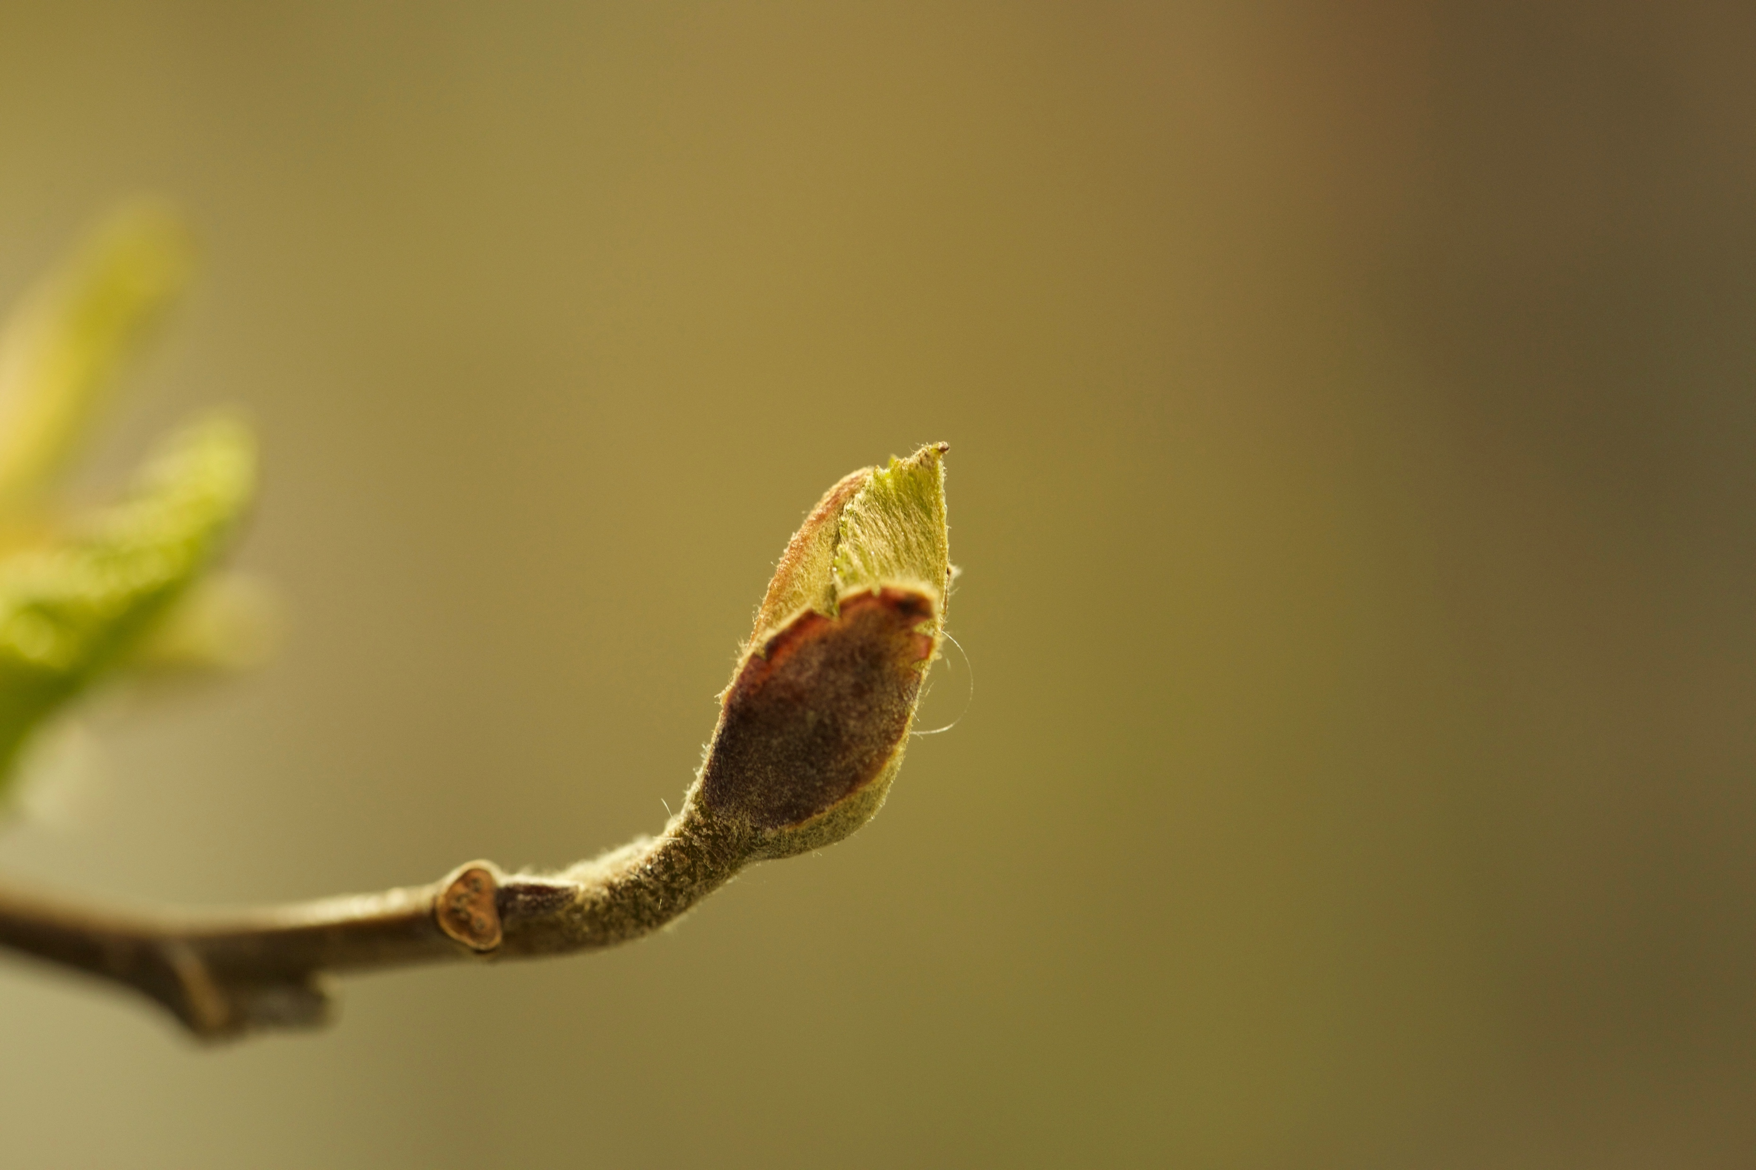
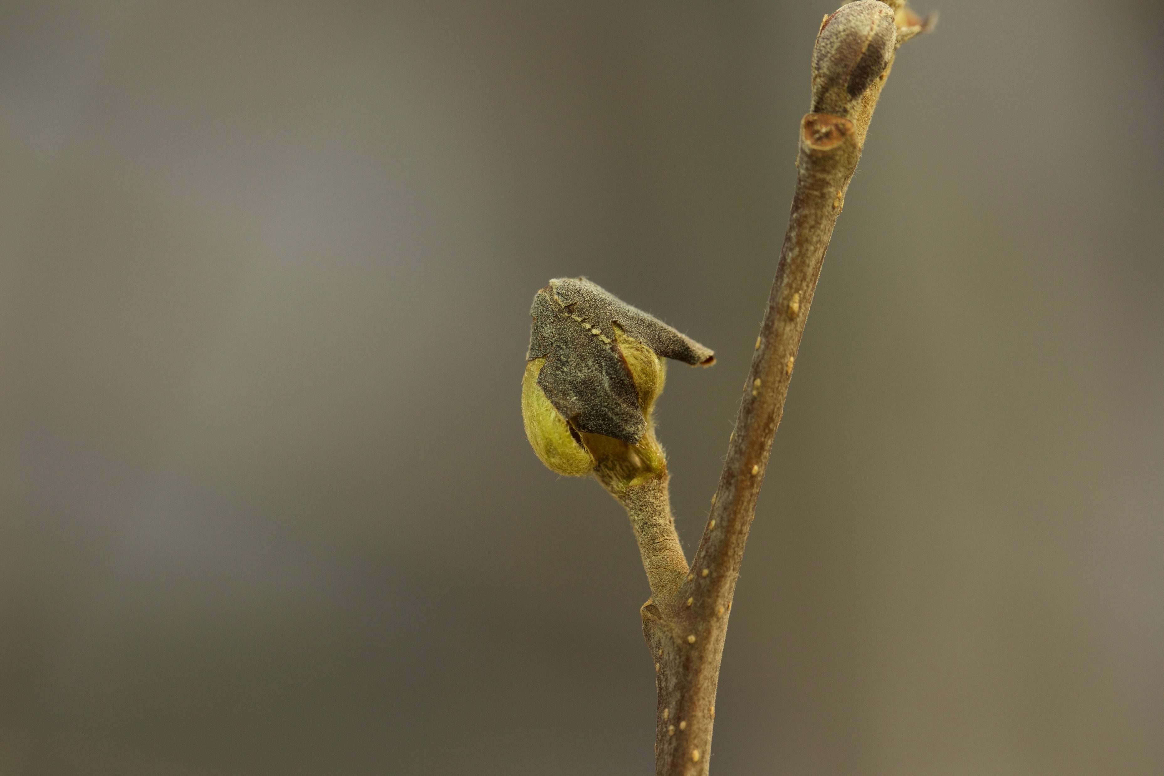
THE EFFECTS OF FALSE SPRING EVENTS ON FOLIATE PHENOPHASES AND THE DURATION OF VEGETATIVE RISK
Catherine Chamberlain & Elizabeth Wolkovich Harvard University, Department of Organismic and Evolutionary Biology | Arnold Arboretum
abstract
methods
results
Trees and shrubs growing in temperate environments are at risk of being exposed to late spring freezes, or false springs, which can be detrimental to growth.
Individuals at certain phenophases (i.e. between budburst and full leafout) are more likely to incur damage from a freezing event.
The rate of budburst, and the length of time between budburst and leafout, is a crucial indicator for predicting level of damage from a false spring event.
We will refer to the timing of these collective phenophases as the duration of vegetative risk.
We exposed 7 native deciduous tree species to a freezing event.
In one treatment, drought conditions were applied prior to budburst and then individuals were put in a growth chamber for 24 hours at -3ºC, the second treatment drought conditions were not applied prior to budburst but individuals were put in the same chamber after budburst was initiated. Both were compared to a control group.
Our results indicate that freezing events occurring between budburst and leafout cause the duration of vegetative risk to increase. This increase could potentially expose leaf buds to more freezing events and subsequently increase the level of damage incurred.
TREATMENTS – Recorded BBCH stage every ~3 days
Treatment A: Control Group – No late spring freezing event prior to leafout nor any drought conditions prior to budburst
Treatment B: Experimental Group 1 – Plants put in growth chamber at -3℃ [3] for 24 hours between budburst and leafout
Treatment C: Experimental Group 2 - Plants had drought conditions applied prior to budburst and then were put in growth chamber at -3℃ for 24 hours between budburst and leafout phenophases
Greenhouse: 12 hr photoperiod, ~58℃ Growth Chamber: 12 hr photoperiod, -3℃
Figure 2: Boxplot comparing the duration of vegetative risk by species for each treatment
background
Table 1: Number of individuals per species for each treatment group
Species | Common Name | A | B | C
Acer pensylvanicum | Striped Maple | 7 | 7 | 1
Alnus incana | Grey Alder | 12 | 12 | 12
Betula alleghaniensis | Yellow Birch | 6 | 6 | 6
Betula populifolia | Grey Birch | 8 | 8 | 8
Corylus cornuta | Beaked Hazel | 1 | 1 | 1
Prunus pensylvanica | Pin Cherry | 7 | 6 | 1
Viburnum cassinoides | Witherod Viburnum | 16 | 15 | 2
Plants are most susceptible to frost damage between budburst and leafout [2,4,1]. Frost tolerance, however, steadily decreases after budburst begins until the leaf is fully unfolded, with leafout being the most susceptible to frost damage [2].
results
Table 2: The average duration of vegetation and standard deviation for each treatment group
Figure 3: Scatterplot comparing the duration of vegetative risk by day of budburst across treatments, with all species pooled.
TREATMENT | MEAN RISK | STAND DEV
A | 17.157 | 6.559
B | 23.436 | 7.044
C | 25.318 | 7.549
conclusions
Figure 1: Schematic of duration of vegetative risk, the timing between budburst and leafout
Our results indicate that spring freezing events extend the time until leafout for most native temperate forest tree species. Therefore, damaging frosts prolong the duration of risk for tree species and put them at risk to multiple late spring freezing events in one year. Spring drought conditions prior to a freezing events also heighten the risk of multiple damaging spring freezing events.
Individuals that initiate budburst later in the season appear to be more sensitive to late spring freezing events. As the day of budburst increased, the duration of vegetative risk increased.
Further studies are necessary to assess how much damage each species incurs from late spring freezing events and if the damage has long-term detrimental effects. The interplay of spring droughts and freezing event should also be analyzed more thoroughly.
objectives
Determine how spring freezing events affect the duration of vegetative risk.
Determine how spring droughts prior to freezing events affect budburst and the duration of vegetative risk.
Assess the level of damage incurred from late spring freezing events on temperate forest seedlings and saplings.
The duration of vegetative risk was extended by nearly a week if a freezing treatment was applied.
Freezing treatments had more of an effect on individuals with budburst occurring later in the season. As day of budburst increased, the duration of vegetative risk increased. Whereas, in the control group, individuals with later days of budburst had faster durations of vegetative risk.
Not all species were affected in the same way.
References
[1] Augspurger, C.K. (2009). Spring 2007 warmth and frost: Phenology, damage and refoliation in a temperate deciduous forest. Functional Ecology 24, 1031-1039
[2] Lenz, A., Hoch, G., Korner, C., & Vitasse, Y. (2016). Convergence of leaf-out towards minimum risk of freezing damage in temperate trees. Functional Ecology, 1-11.
[3] Schwartz, M.D. (1993). Assessing the onset of spring: A climatological perspective. Physical Geography, 14, 536-550.
[4] Vitasse, Y., Lenz, A., Hoch, G. & Korner, C. (2014). Earlier leaf-out rather than difference in freezing resistance puts juvenile trees at greater risk of damage than adult trees. Journal of Ecology, 102, 981-988.
Viburnum cassinoides after freezing treatment
Alnus incana budburst without freezing treatment
Alnus incana budburst after freezing treatment

